Slide 1



“Probabilistic Methods for Counterfactual Explanations”
Oleksii Furman 2nd year PhD
Supervisor: dr hab. inż. Maciej Zięba

Slide 2
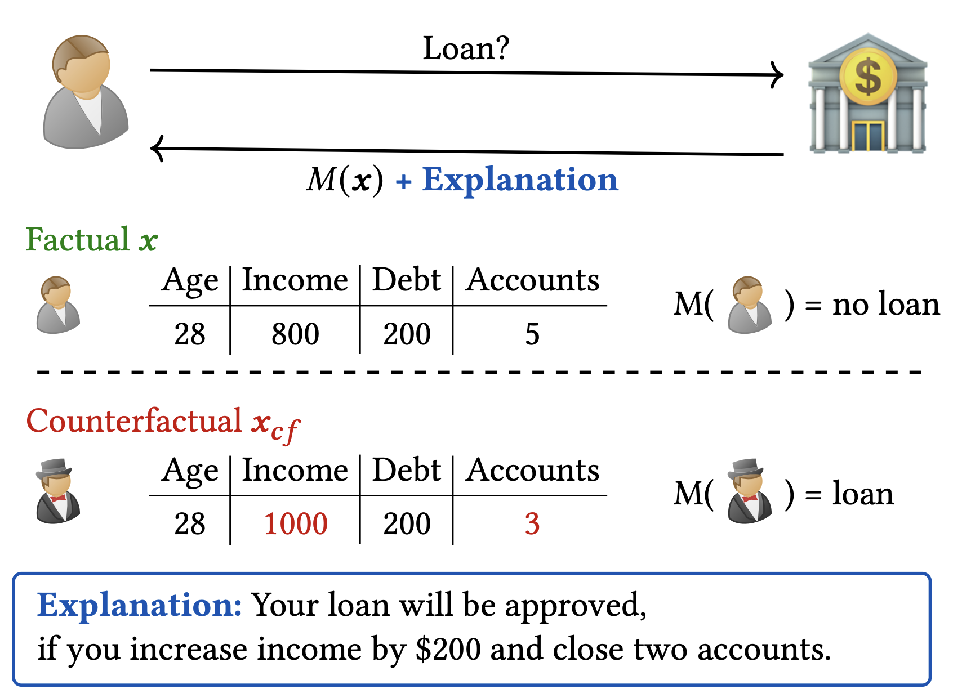
What is Counterfactual Explanations?

Slide 3
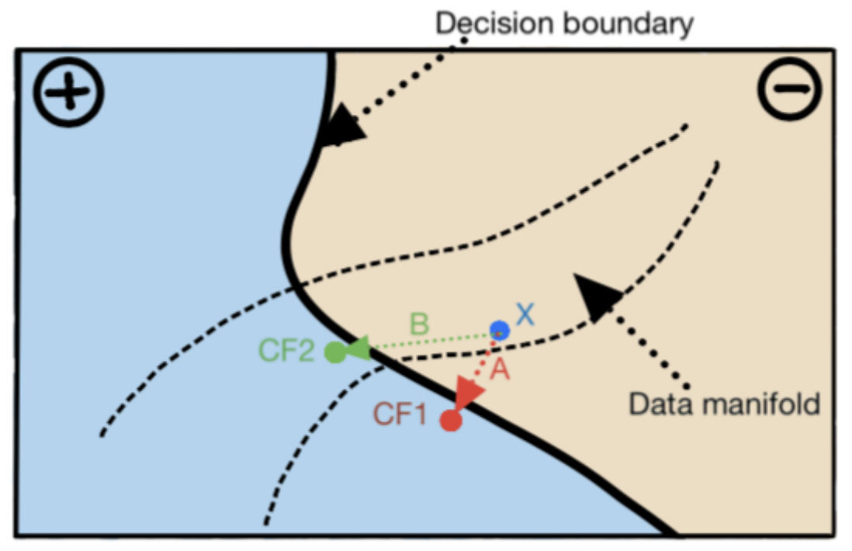
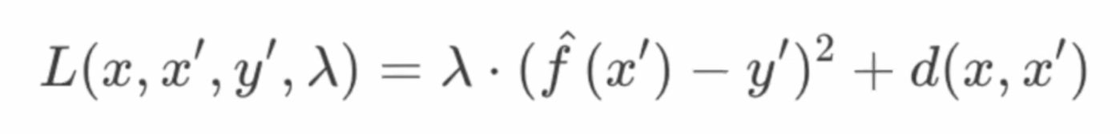
What is Counterfactual Explanation (CF)?
Difference between model prediction for CF and desired outcome
Distance between original input and CF

Slide 4
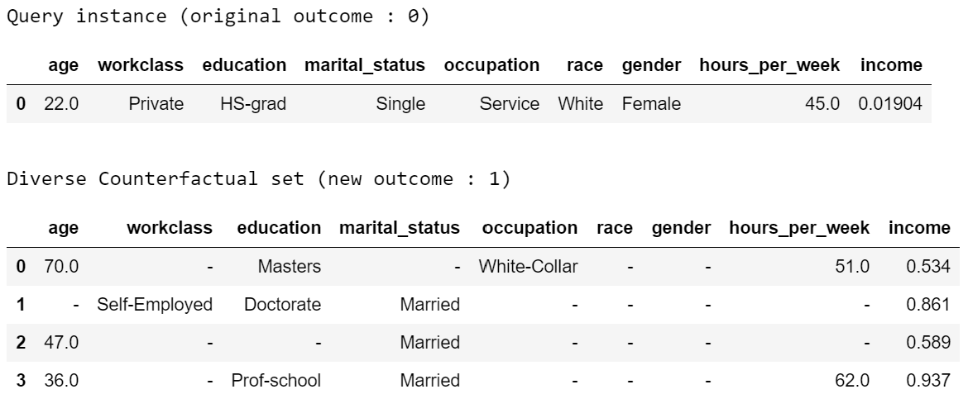

Slide 5
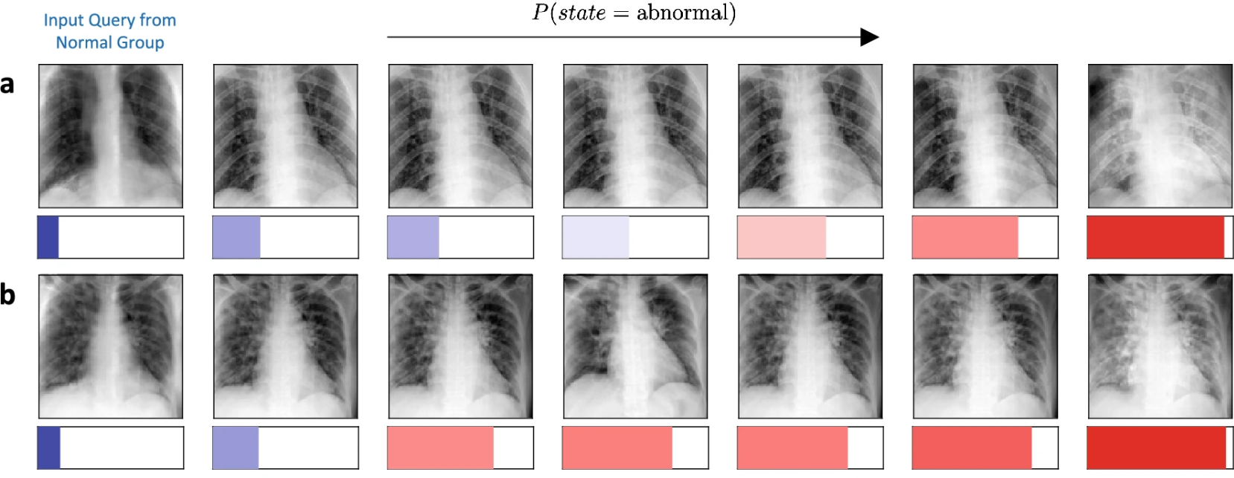

Slide 6
Properties
Validity: ensuring the counterfactual changes the outcome
Sparsity: minimizing the number of feature changes
Similarity(proximity): keeping the counterfactual close to the original input
Plausibility: ensuring the counterfactual is realistic.
Actionability: focusing on features that can be practically changed
Diversity: Most methods produce single or few counterfactual candidates
Robustness: Explanations become invalid when models are updated or retrained
Fairness: ensures that CEs are equitable across demographic groups, avoiding biased, unfeasible, or inconsistent recourse options.
Causal Reasoning: Explanations do not ignore real-world causal dependencies

Slide 7
Research Gap
Substantial gap in developing comprehensive probabilistic frameworks for counterfactual explanations
Need for methods that ensure validity, plausibility, robustness, and diversity simultaneously
Causality integration into counterfactual explanations.
Fairness in Counterfactual Explanations.

Slide 8

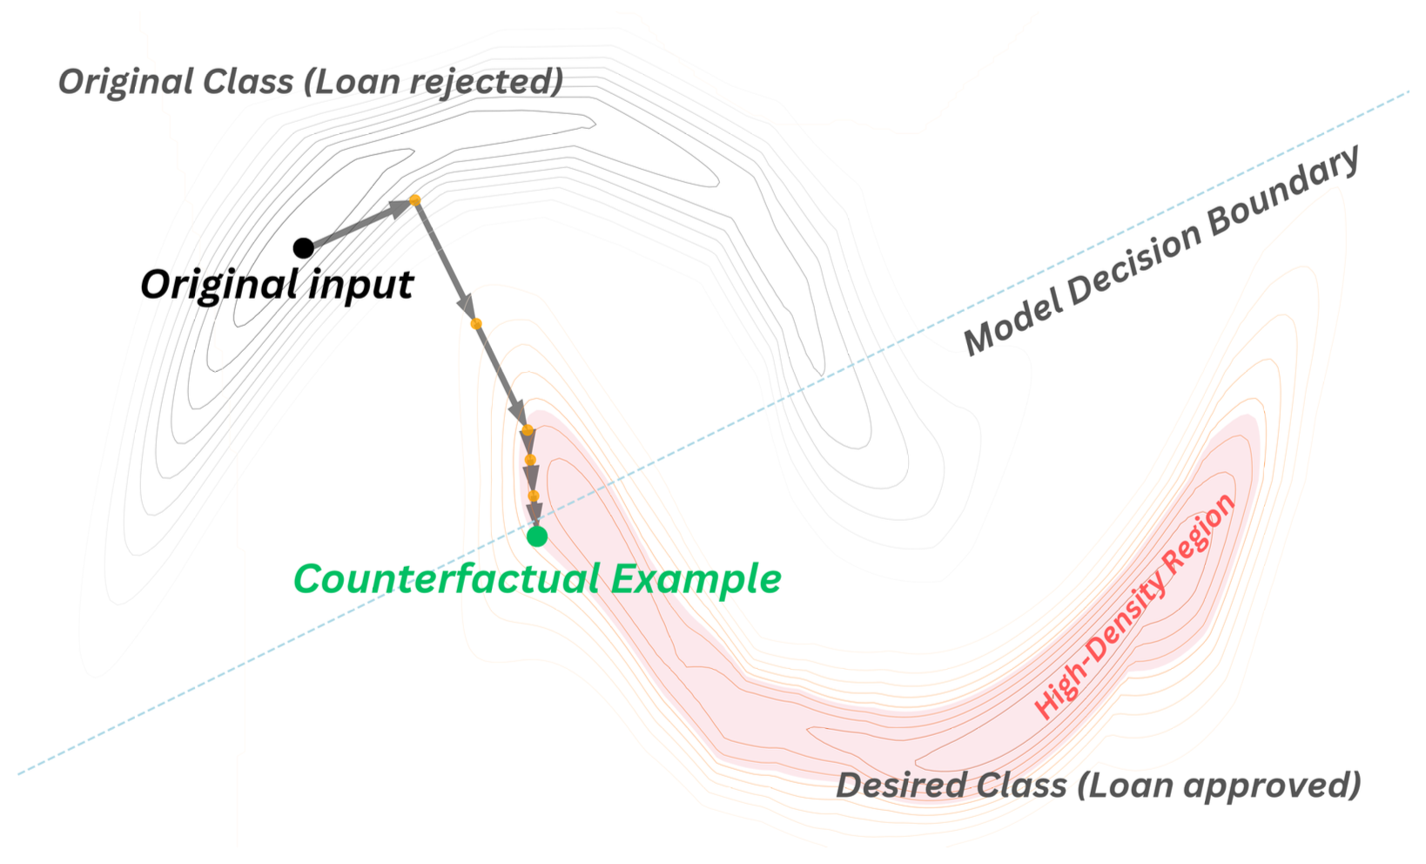
PPCEF: Probabilistically Plausible Counterfactual Explanations with Normalizing Flows

Slide 9
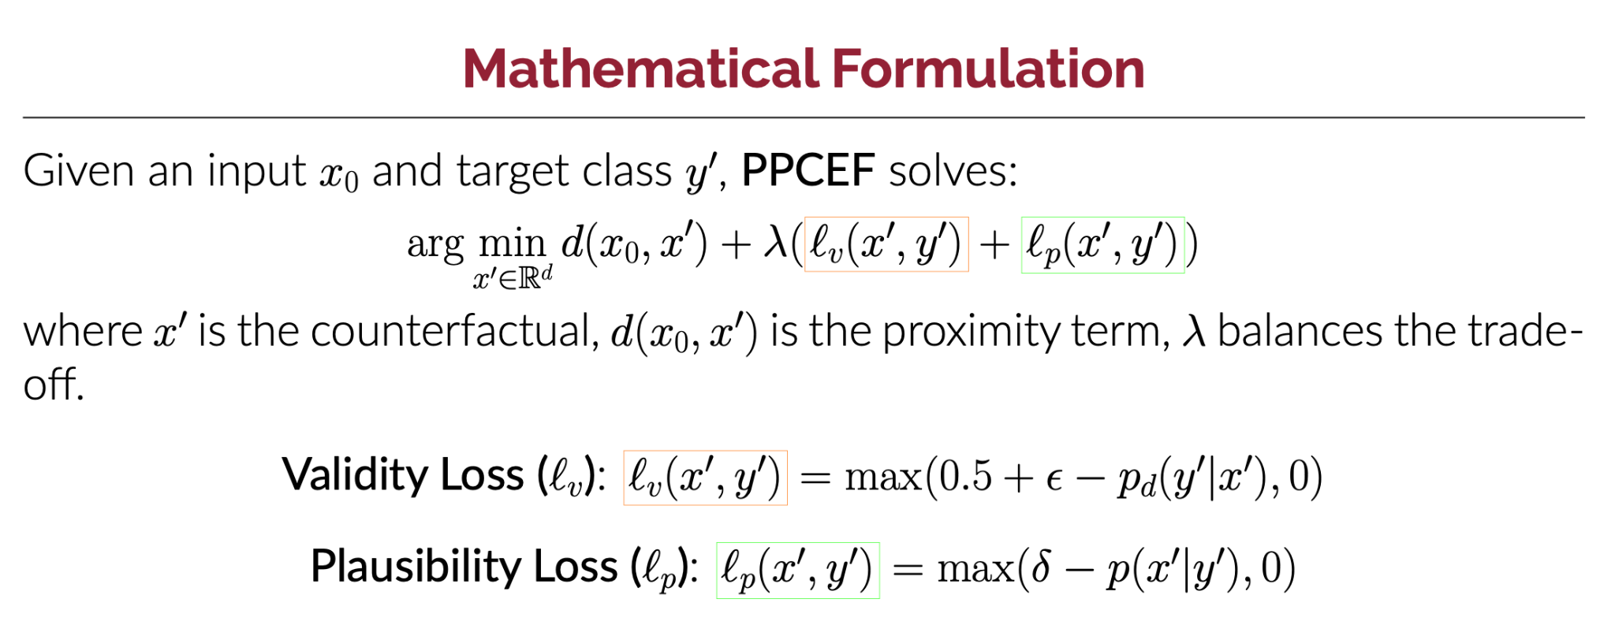
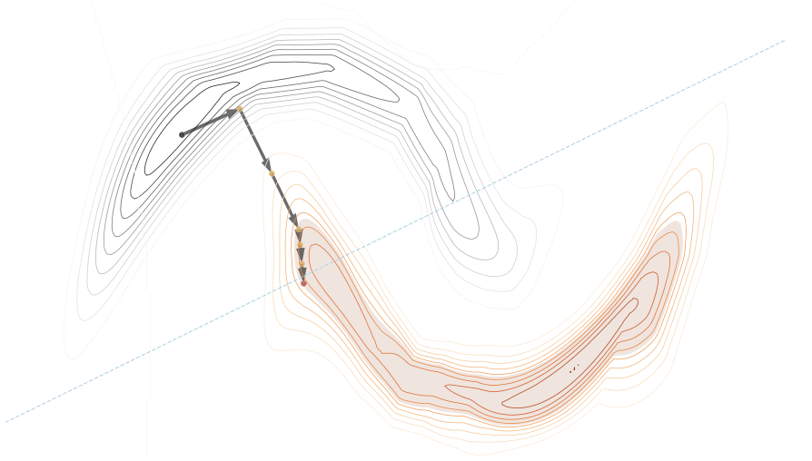

Slide 10
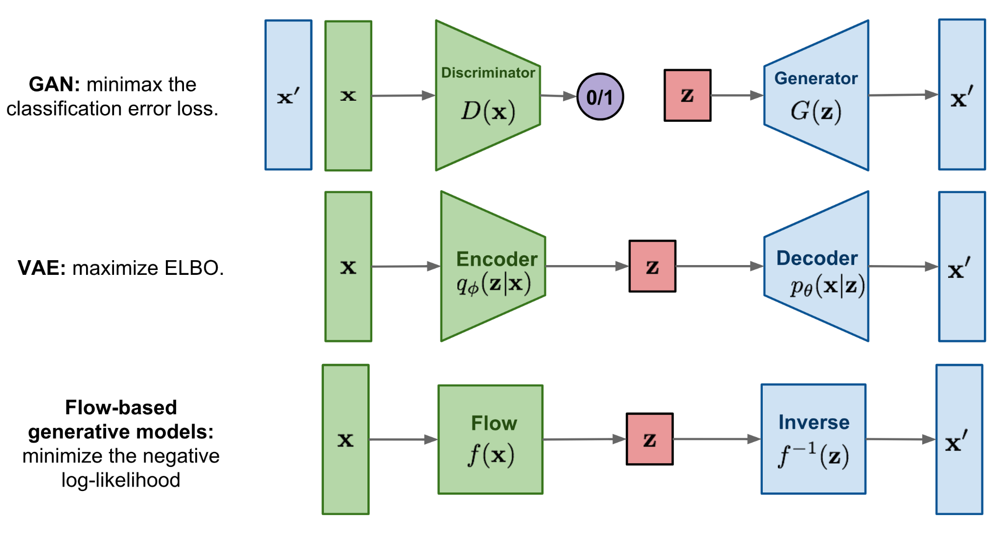
Normalizing Flow

Slide 11
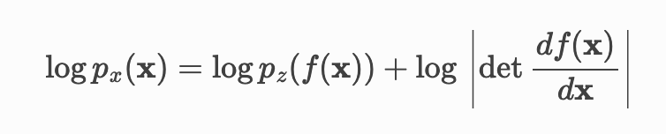

Slide 13
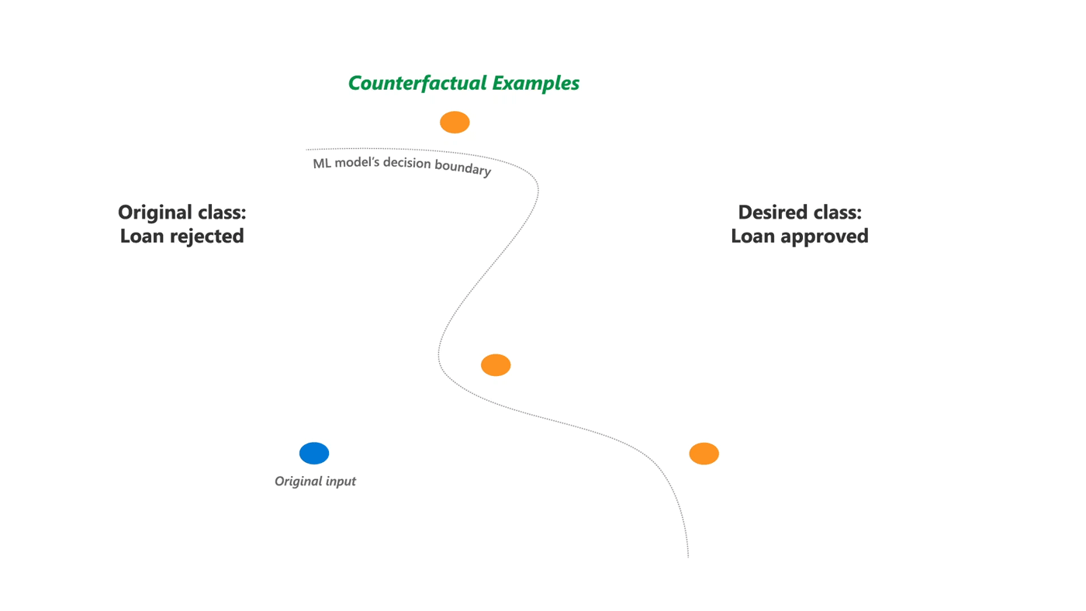
Diversity in Counterfactual Explanations
Multiple diverse counterfactuals to provide users with different options.
Obtain a Master Degree
Increase Salary by $1000
Decrease Debt by $500
Mothilal, Ramaravind K. et al. "Explaining machine learning classifiers through diverse counterfactual explanations." FAccT. 2020.

Slide 14



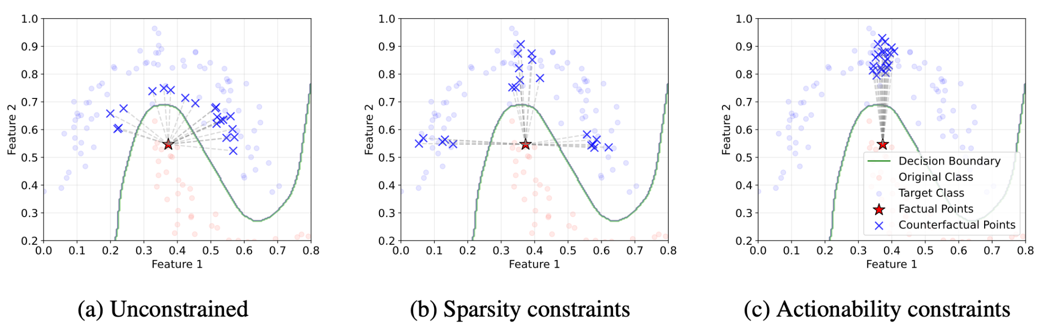
DiCoFlex: Model-agnostic diverse counterfactuals with flexible control
Normalizing Flow Model:

Slide 15
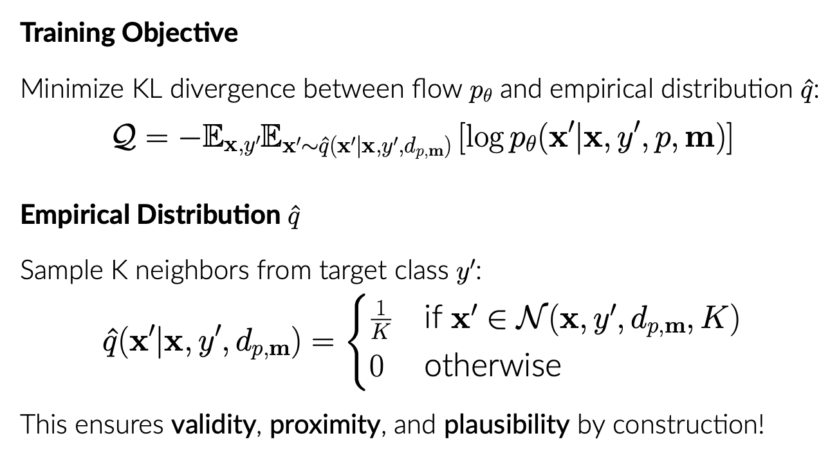
DiCoFlex: Model-agnostic diverse counterfactuals with flexible control
Normalizing Flow Model:

Slide 16
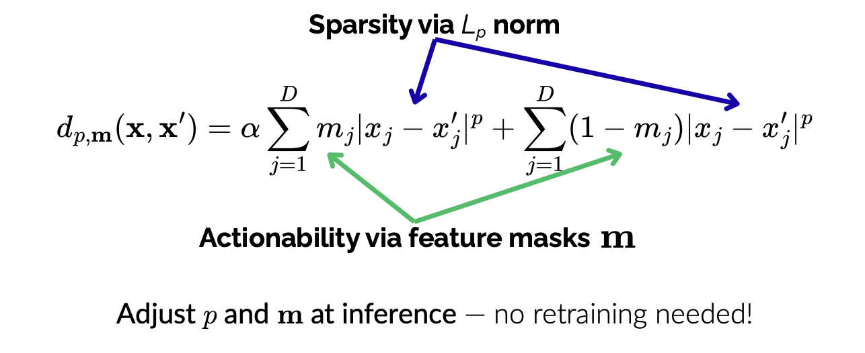
DiCoFlex: Model-agnostic diverse counterfactuals with flexible control
p=2.0, m=[1,1]
p=0.01, m=[1,1]
p=0.01, m=[0,1]

Slide 17
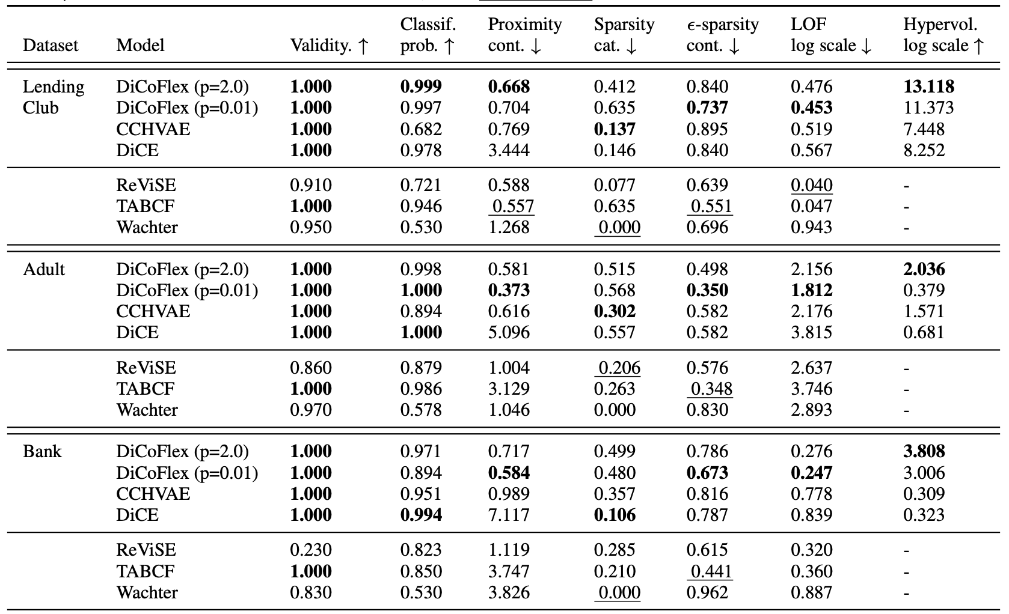
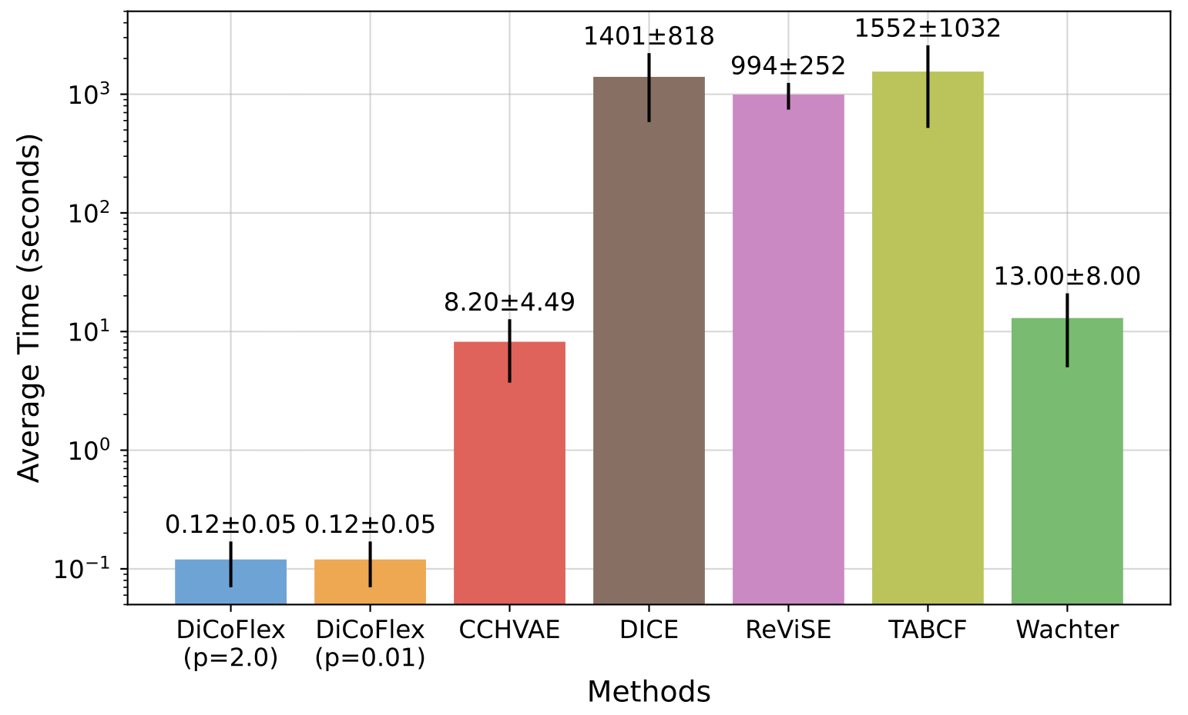
DiCoFlex: Model-agnostic diverse counterfactuals with flexible control

Slide 18
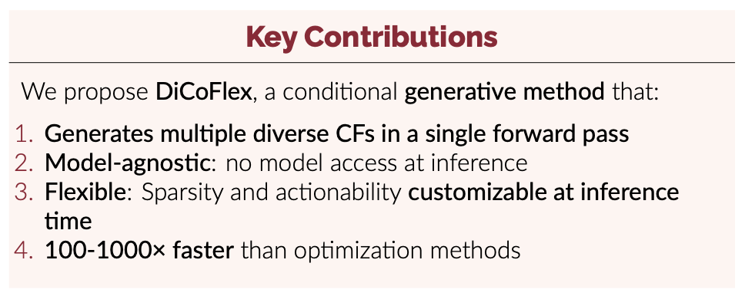
DiCoFlex: Model-agnostic diverse counterfactuals with flexible control

Slide 19
Work In Progress:
1. Generative CEs without ground truth at all (Generative Flow Networks)
3. In Context CE generation

Slide 20
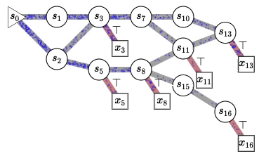
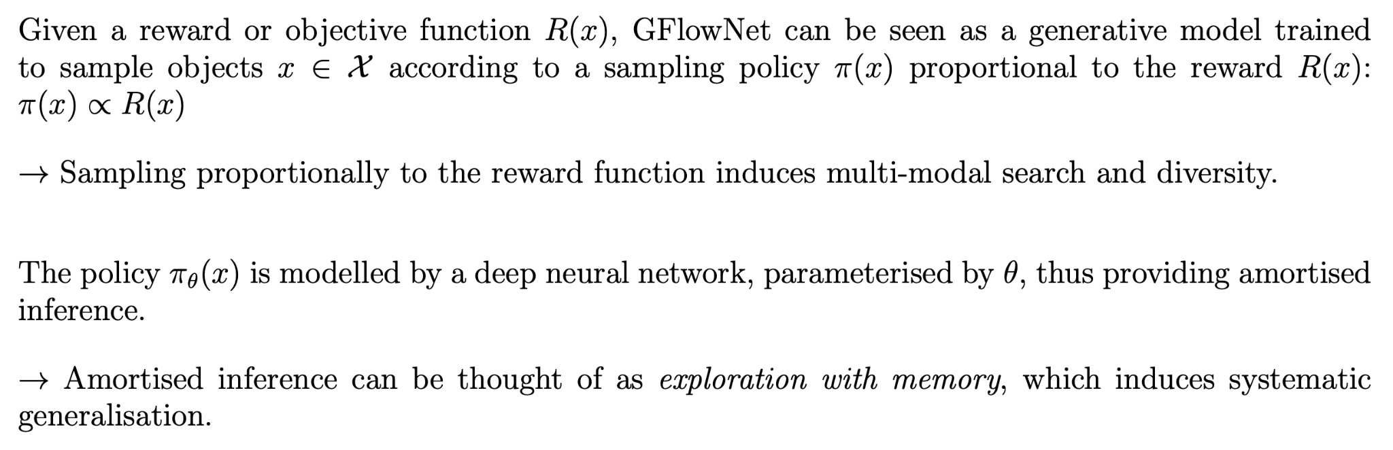
Generative Flow Networks:

Slide 21
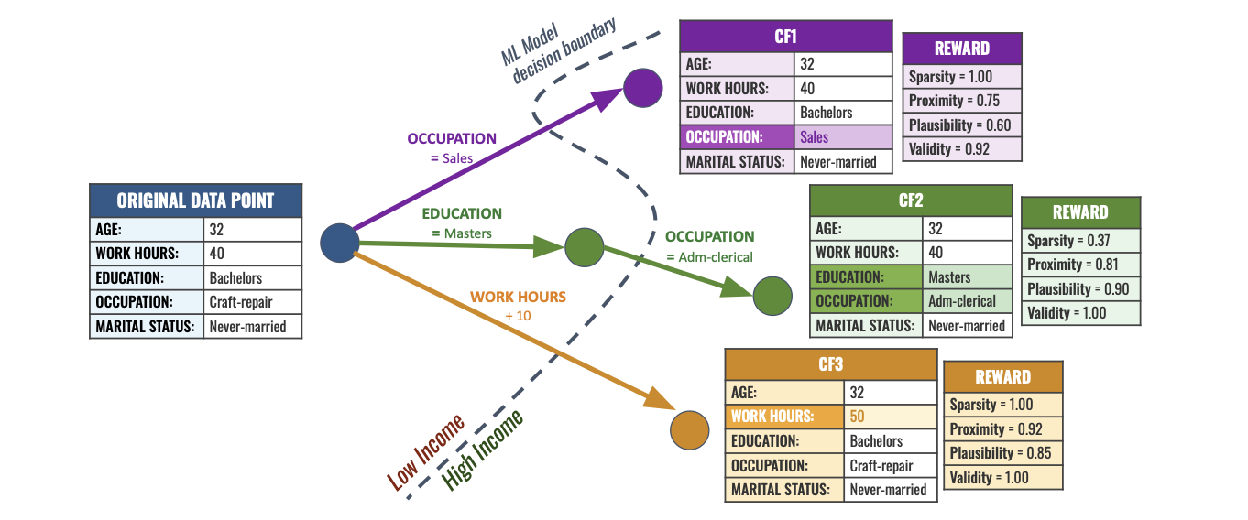
CounterFlowNet: From Minimal Changes to Meaningful Counterfactual Explanations

Slide 22
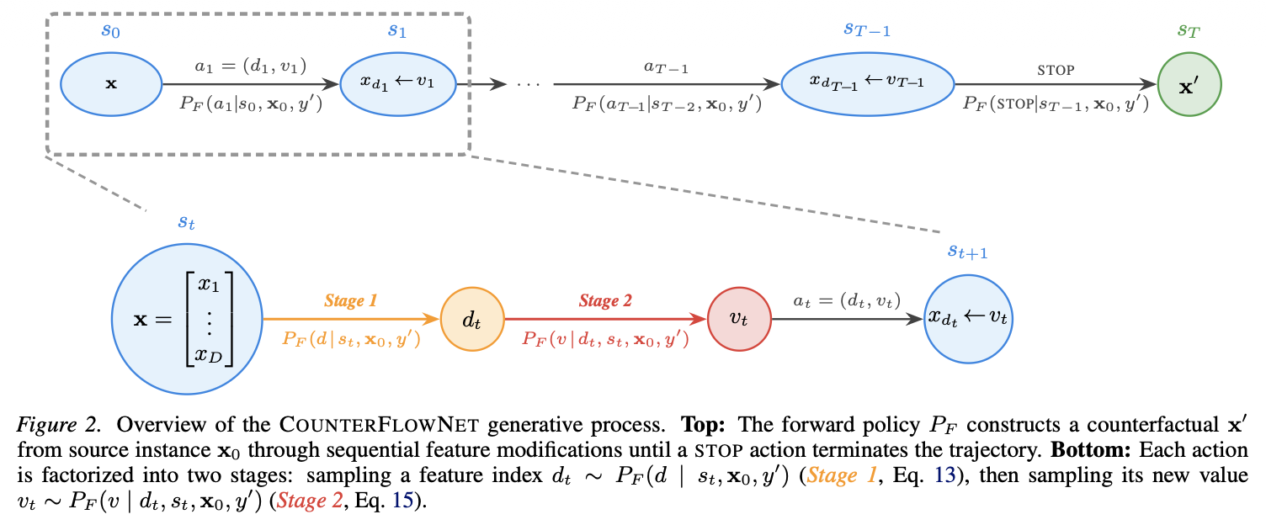
CounterFlowNet: From Minimal Changes to Meaningful Counterfactual Explanations

Slide 23
CounterPFN: In-Context Counterfactual Generation
Training Data: Structural Causal Models (SCMs)
Sample random MLP-based SCMs to define causal graphs and mechanisms
Generate ground-truth counterfactual pairs via Pearl’s abduction-action-prediction
Each SCM produces (factual, intervention) → counterfactual supervision pairs
Causal consistency is built into the data, not added as a regularizer
Generation Model: TabPFN (Prior-Fitted Network)
Transformer pre-trained on diverse synthetic SCM datasets
In-context learning: infers causal structure from context data at inference time
Single forward pass generates counterfactuals for any new dataset (no retraining)
Predicts Δ = x_cf − x_factual — the minimal change to flip the predicted outcome

Slide 24
Thank you
for your attention
Oleksii Furman

